Slide 1


Author: Doris Amoakohene Supervisor: Toby Hocking Co-Worker: Anirban Chetia
Title:
Benchmarking Performance for the data.table Package
Outline of Presentation
Introduction
Visualizing the atime result of various functions with data.table
Visualizing the atime result for performance regression
GitHub Action
Conclusion
1
2
3
4
5

Slide 2


1: Introduction
Comparative Benchmarking: Comparing data.table to other packages in R and python that perform similar tasks
data.table
pandas
data.table
Other R packages
VS.
VS.
Performance Testing: We evaluate the performance of different versions of the data.table package by benchmarking their memory and time usage.

Slide 3
1: Introduction
Benchmarking packages like airspeed velocity, conbench, touchstone, and pytest-benchmarks rely on a single data size N for benchmarking.
We utilize the atime package which allows for a sequence of N values and generates a visual plot.

Slide 4
1: Introduction
The ‘atime’ package in R is designed for asymptotic timing, enabling the comparison of time and memory usage across various R code as a function of the input size, denoted by ‘N’.
It also has a built in GitHub action which was developed by Anirban Chetia, my co worker.

Slide 5
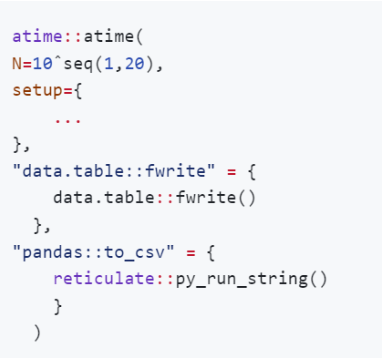
2. Visualizing the atime result of various functions with data.table
atime::atime function for comparative benchmarking
data size to vary over
expression to evaluate for every data size, before timings.
named list of expressions to time.

Slide 6
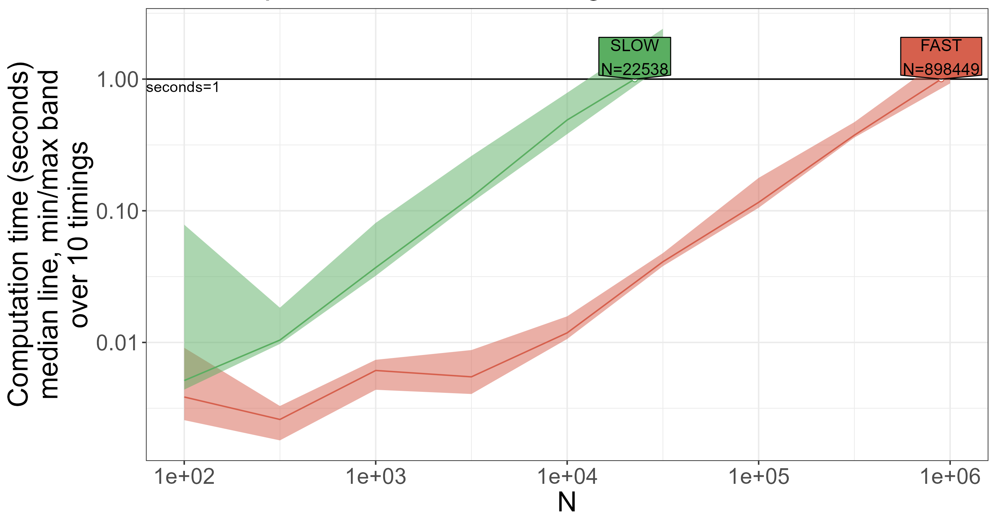
2: Comparing the performance of two functions to illustrate fast and slow execution

Slide 7
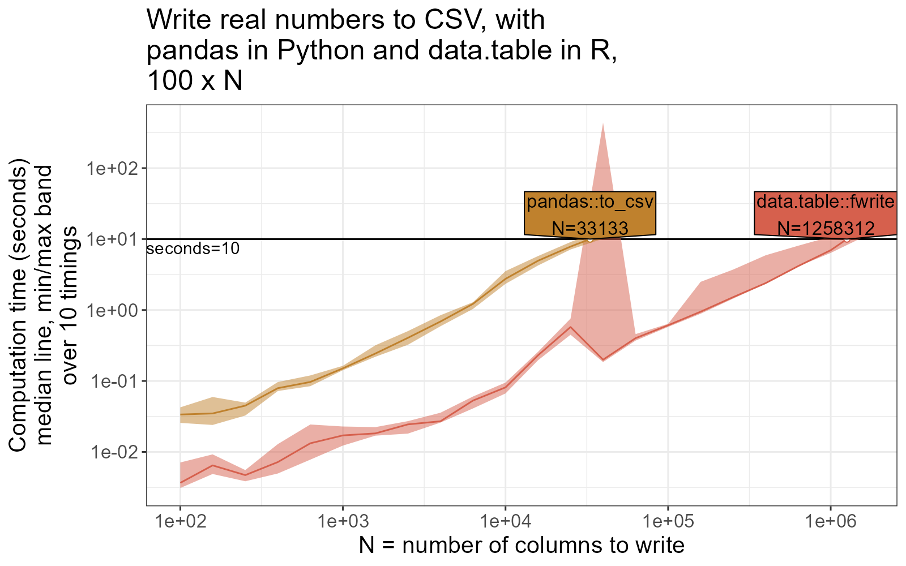
2. Benchmarking data.table::fwrite against pandas::to_csv

Slide 8
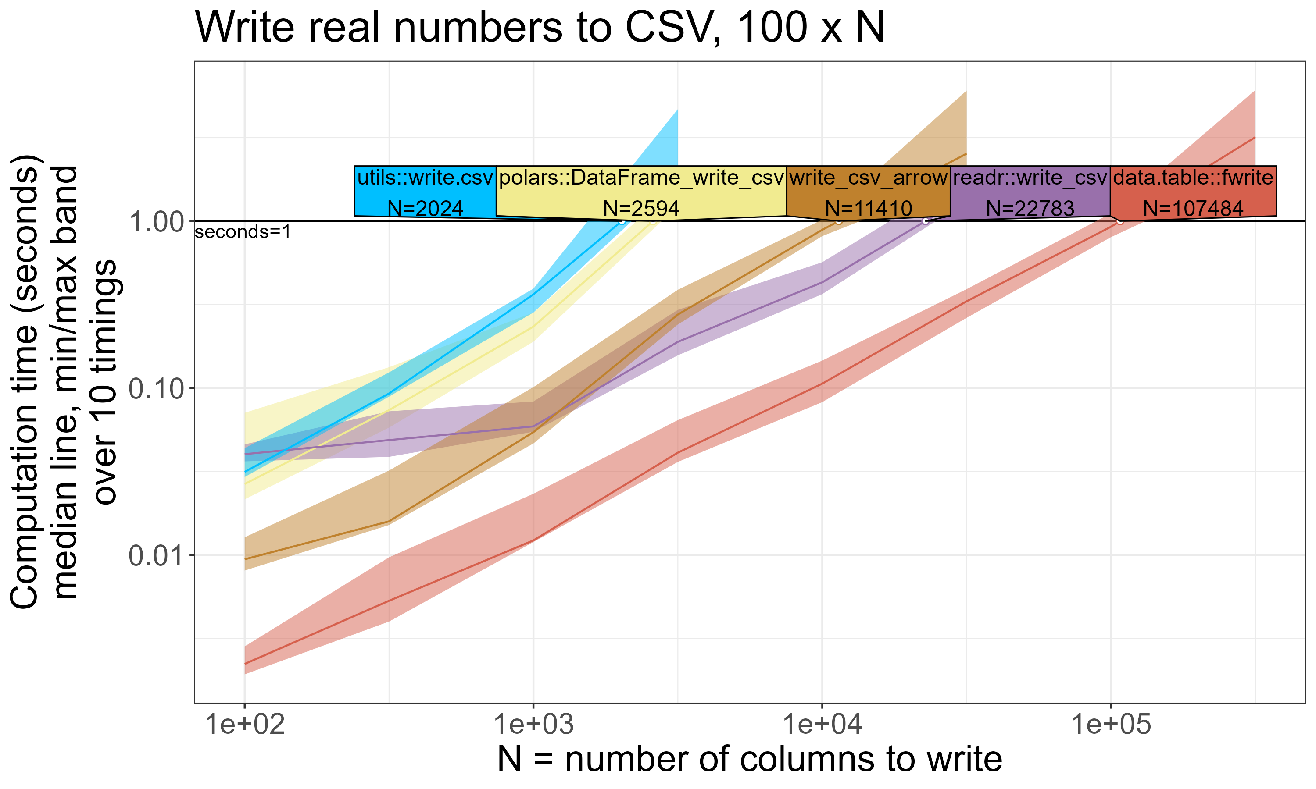
2: Benchmarking data.table::fwrite against other R packages (readr , polars, utils) for csv writing

Slide 9
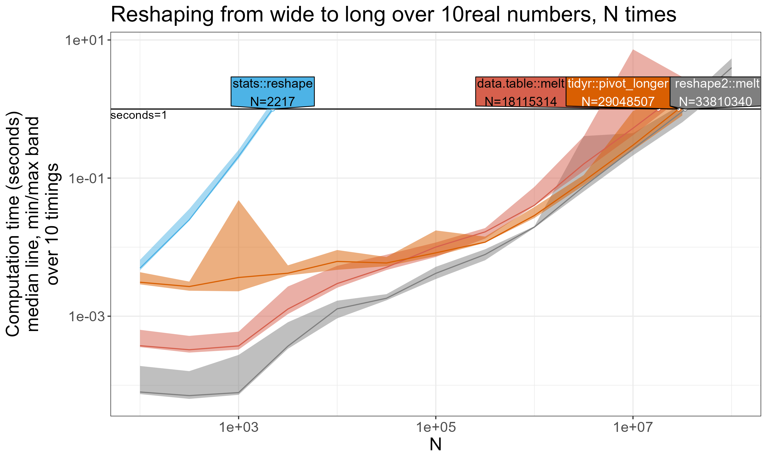
2: Benchmarking data.table::melt against other R packages (reshape, tidyr, reshape2) for wide-to-long data reshaping
Data.table isn't always fastest, which is why we use benchmarking to identify optimization opportunities and improve performance

Slide 10
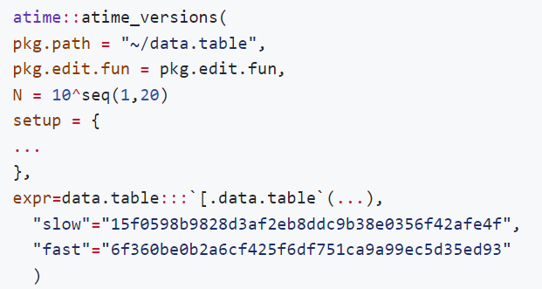
3. Visualizing the atime result for performance regression
atime_versions, atime function for performance testing over different version of an R package
Path to git clone of repo containing R package(data.table).
function called to edit package before installation

Slide 11
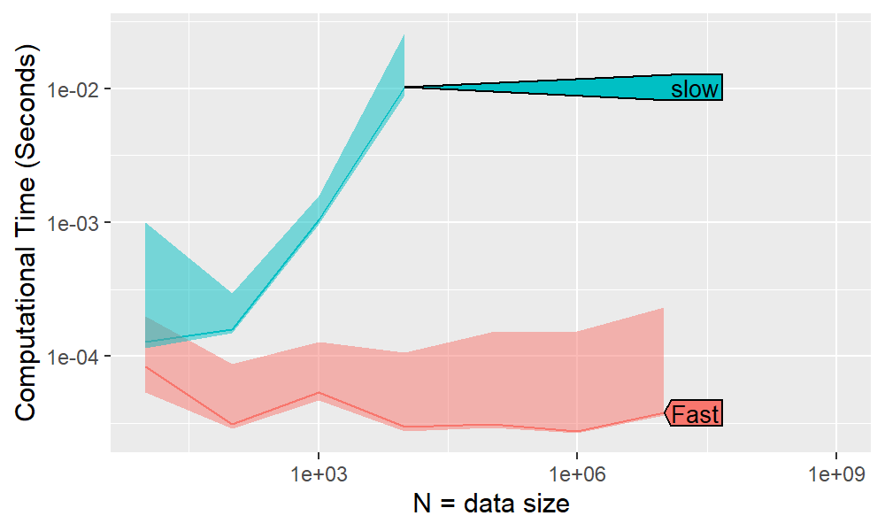
3: setDT extremely slow for very wide input #5427

Slide 12
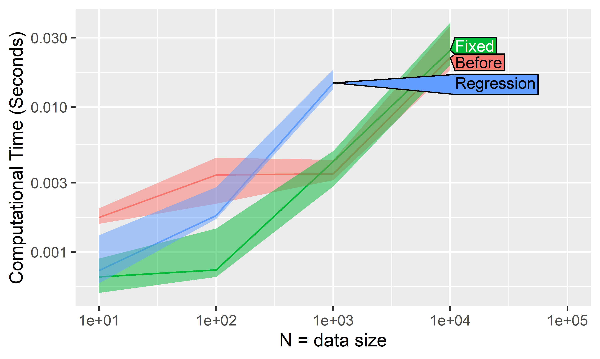
3: groupby with dogroups (R expression) performance regression #4200

Slide 13
3: GitHub Action
A GitHub Action is an automated workflow that can be set up in a GitHub repository to perform various tasks such as building, testing, and deploying software
It helps to identify and address any performance issues, ensuring that the package is performing well.
Our GitHub Action for R packages runs atime::atime_pkg and comments the generated results on pull requests to help identify potential performance regressions introduced from the incoming changes.

Slide 14
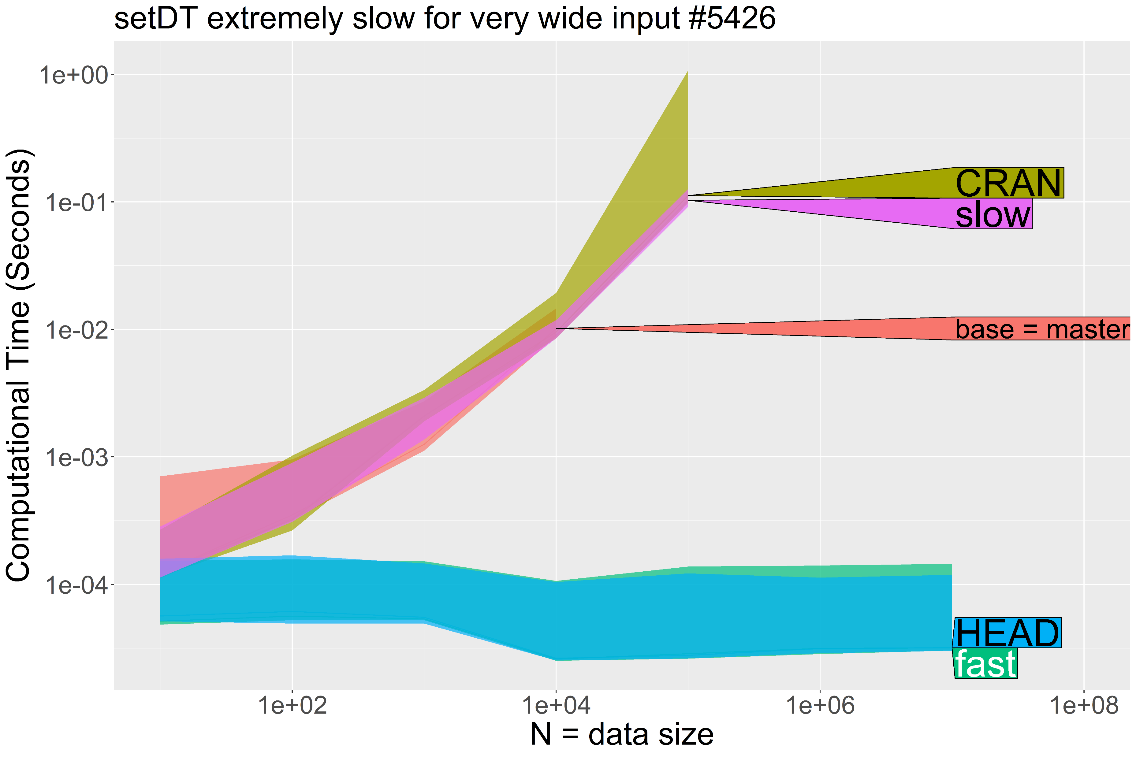
3: Head is Fast, improved speed relative to slow/CRAN/base

Slide 15

data.table is an efficient package for data manipulation.
atime package proves to be exceptionally useful for conducting comparative benchmarking and performance testing.
5: Conclusion

Slide 16

GitHub:DorisAmoakohene
LinkedIn: Doris Amoakohene
Email: @daa464@nau.edu

